Slide 1


Slide 2


Creating a functional software for small business - ByteStock
Second Year Project Synopsis
Submitted by
ROLL | NAME
2301010210 | Harshit Chaurasia
2301010206 | Ayush Gupta
2301010209 | Nikhil Kumar
2301010242 | Ishika
Industry Mentor: Mr. Gauri Shankar
Faculty Mentor: Ms. Suman
Notes:
New Courses replaced with New Programmes

Slide 3

Project Overview
We are developing a functional software for small businesses to efficiently manage their inventory and can also calculate GST bills. The system tracks stock levels, provides in-app alerts for low inventory, and allows easy price adjustments. It simplifies billing by giving GST calculations, ensuring compliance and accuracy. The user-friendly interface makes inventory and financial management seamless.
Notes:
New Courses replaced with New Programmes

Slide 4
About the Problem
Problems Identified: Managing inventory manually is time-consuming, and lacks real-time stock updates.
Issues or Problems: Difficulty in tracking inventory, lack of low-stock alerts, and manual GST billing complexities.
Need of Solution: To automate inventory tracking, provide real-time notifications, and generate GST-compliant effortlessly.
Existing Solution: Current solutions are either too complex for small businesses or lack key features like automated stock alerts and seamless GST billing. A user-friendly app is needed to simplify these processes.
Notes:
New Courses replaced with New Programmes

Slide 5
Problem Statement
Define the Problem Clearly:
Manual inventory tracking and GST billing cause errors and inefficiencies.
Why is it Important?
Stock mismanagement and billing mistakes affect operations and compliance.
Expected Impact of Solving This Problem:
Automation improves accuracy, efficiency, and business performance.
Notes:
New Courses replaced with New Programmes

Slide 6
Objectives
Inventory Alerts: Tracks stock and notifies when low.
Smart Pricing: Adjusts prices based on stock and demand.
GST Billing: Auto-generates GST-compliant invoices.
Easy to Use: Simple interface for smooth management.
Notes:
New Courses replaced with New Programmes

Slide 7
Methodology, Tools, and Techniques
Methodology: Start learning about tools used in this project one by one and then apply it and make a functional software.
Tools: Flutter/React (frontend), Node.js/Python (backend), Firebase/MySQL (database).
Techniques: Automated inventory tracking, AI-based pricing, real-time alerts.
Notes:
New Courses replaced with New Programmes

Slide 8
Methodology
Plan the App: Define the features you need (e.g., product info, stock levels) and decide the app’s purpose and target audience.
Design the System: Plan how the app will look (UI/UX) and choose the technologies to use for the app (e.g., frontend, backend, database).
Develop the App: Build the user interface and backend, and make sure the app can handle stock data and user actions.
Test the App: Test the app to ensure everything works properly, like checking if stock updates and data display correctly.
Launch and Maintain: Launch the app, fix any bugs, and keep the app updated with new features or improvements over time.
Notes:
New Courses replaced with New Programmes

Slide 9
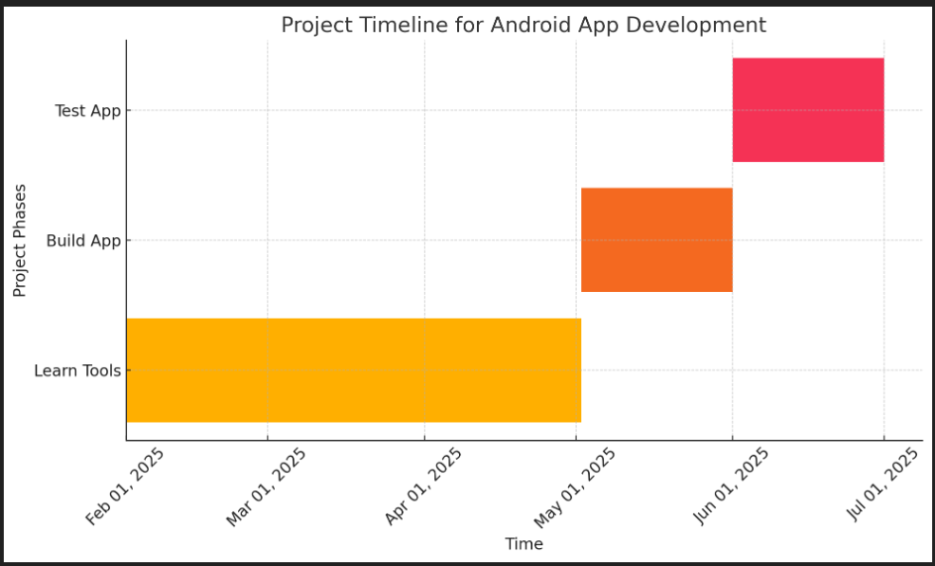
Project Timeline
Notes:
New Courses replaced with New Programmes

Slide 10
References
Websites and Online Learning:
YouTube. (2023). How to build a simple inventory management app: Step-by-step guide. Retrieved from https://www.youtube.com/watch?v=uEhmQd0Z1CA&t=11410s
Udemy:
Mastering mobile app development for business: From concept to deployment. Retrieved from https://www.udemy.com/course/mobile-app-development
Digital India:
Promoting GST-compliant systems for small businesses. Retrieved from
https://www.digitalindia.gov.in/gst
Notes:
New Courses replaced with New Programmes

Slide 11
Expected Results & Impact
Expected Results:
Efficient inventory management for small shops.
GST calculated price generation.
Notifications for low stock levels.
A working prototype as a deliverable for user feedback.
Impact:
Helps small shops streamline operations and reduce manual work.
Benefits include accuracy in stock tracking and timely billing.
Future scope for adding features like supplier management and sales analytics.
Notes:
New Courses replaced with New Programmes

Slide 12
THANK YOU

